Slide 1
Calculus for Machine Learning
Study of change

Slide 2
The wholesale price of a designer shirt is $25. A retail store
has determined that if they sell the shirt for $40, consumers
will purchase 55 shirts per month. The manager of the men’s
department knows that for each dollar decrease in price, 5
more shirts will be sold each month. What selling price will
yield the greatest monthly profit for the store?
Consider X is as decrease in price of shirt hence price would be (40-X)
P(x) = (profit per shirt) * (number of shirts sold)
P(x) = (15-X) * (55+5X)
=825 + 20X − 5X²

Slide 3
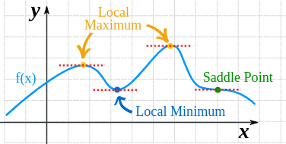
Minima or Maxima of Function

Slide 4
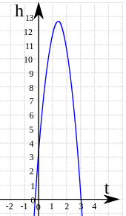
How to find minima or maxima of function
H = 3+14t-5t²
^{Differentiate above function}
^{dh/dt = 14-10t}
^{Now suppose at specific t}
^{dh/dt = 0}
^{Hence t = 14/10 = 1.4}

Slide 5
Rules of thumb to find maxima or minima
When a function's slope (First derivative) is zero at x, and the second derivative at x is:
Less than zero it is local maxima
Greater than zero local minima
Equal to zero then test fails

Slide 6
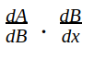
Chain Rule
f(x)= A(B(x)) # composite function example (x+1)²

Slide 7
Partial Derivatives
In function of 2 or more variable, It is derivative of one variable with respect to others
So suppose we have function f(x,u)
Then we hold u constant and see changes in x.
And similarly for other variable u we will keep x constant and see changes in function f(x,u)

Slide 8
Let’s solve f(x,z) = 2z³x²

Slide 9
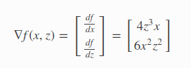
Gradients
Gradient stores partial derivative of multivariate function
It calculates slope in multidimensions
To calculate slope we have to differentiate each dimension independently
To do this ve use partial derivatives of each independent dimensions
Always points in the direction of greatest increase of a function

Slide 10
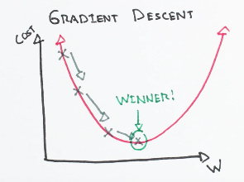
Gradient descent
Gradient descent is optimization algorithm to find local minima.
Suppose we have to minimize f(x)
Initialize parameter X
For n iterations:
X = X-ɳ*▽f(x)
Where ɳ is learning rate
▽f(x) is first derivative

Slide 11
Gradient ascent
To maximize function f(x)
Initialize parameter X
For n iterations:
X = X+ɳ*▽f(x)

Slide 12
How Gradient descent will work for multidimensions?

Slide 13
Linear Algebra for Machine Learning

Slide 14
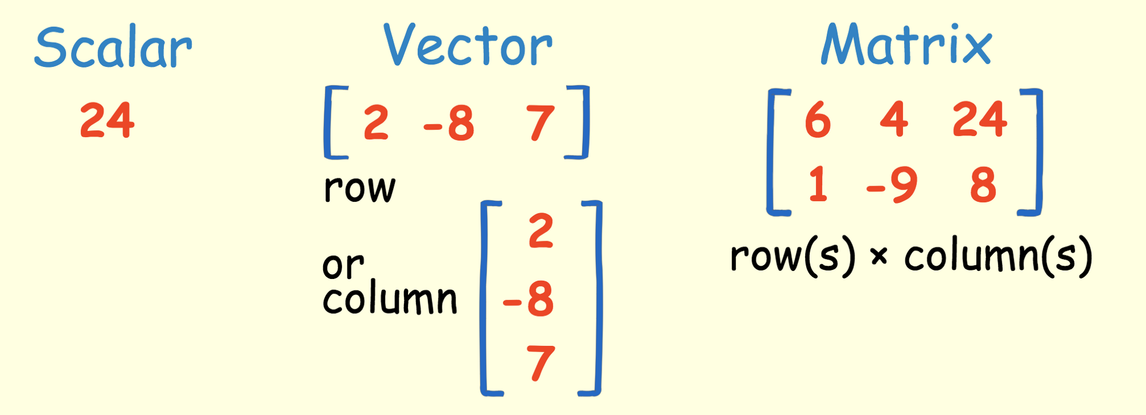

Slide 15
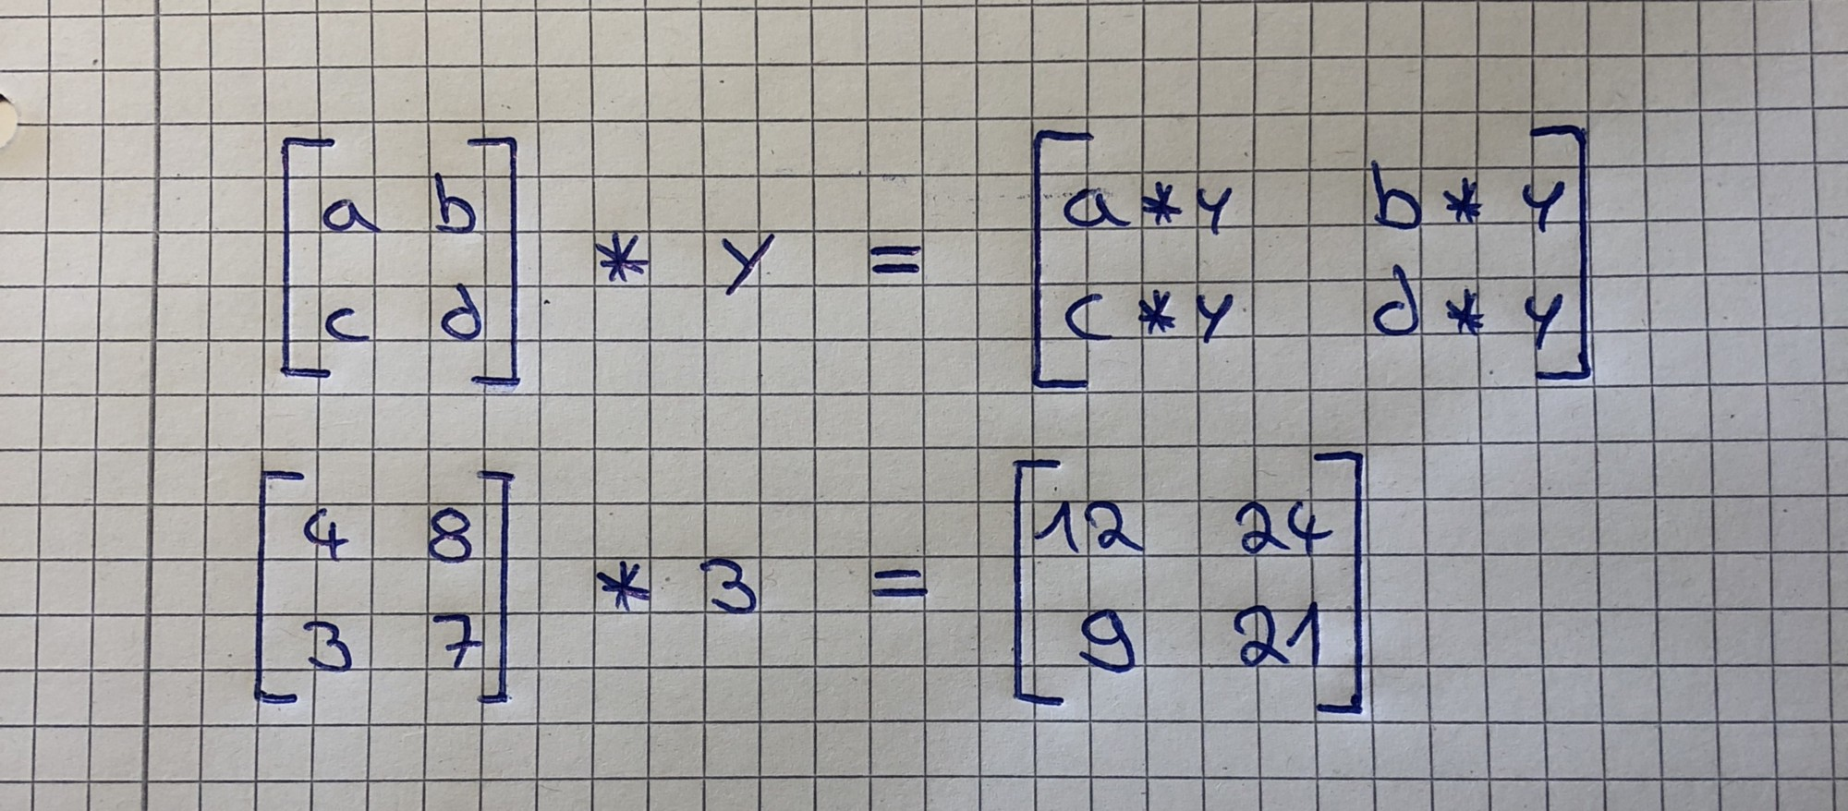
Matrix scalar multiplication

Slide 16
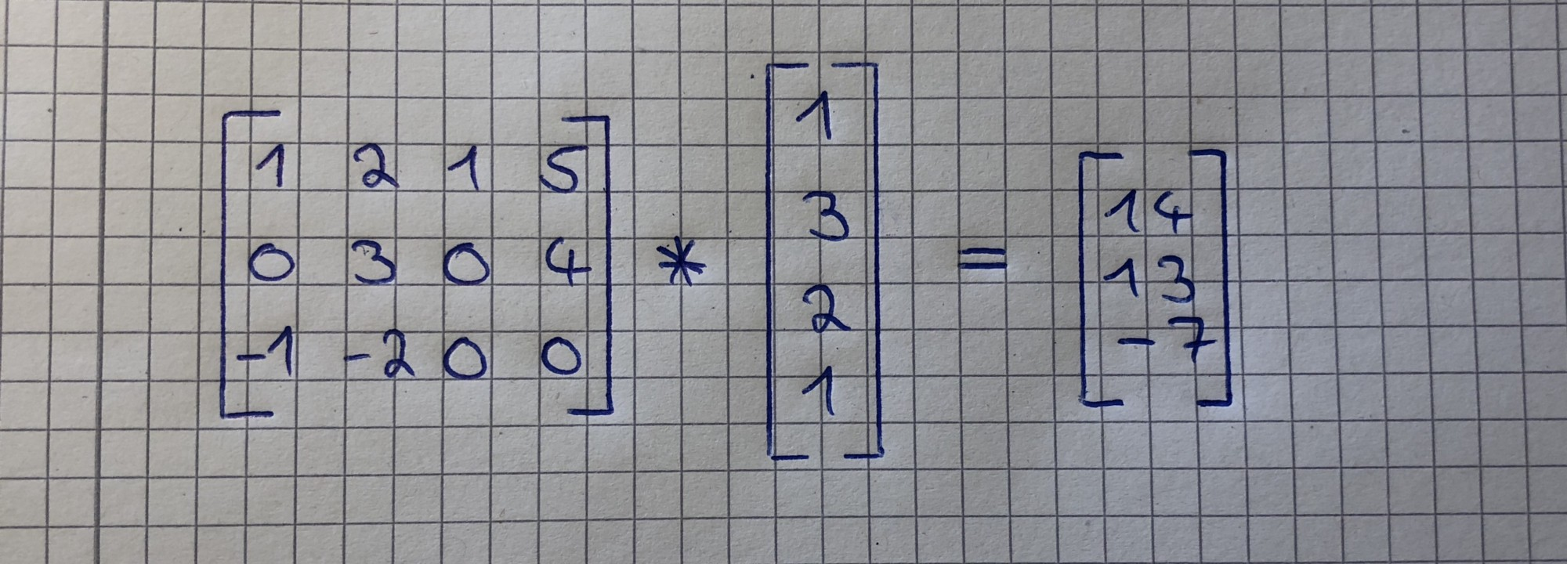
Matrix-Vector Multiplication

Slide 17
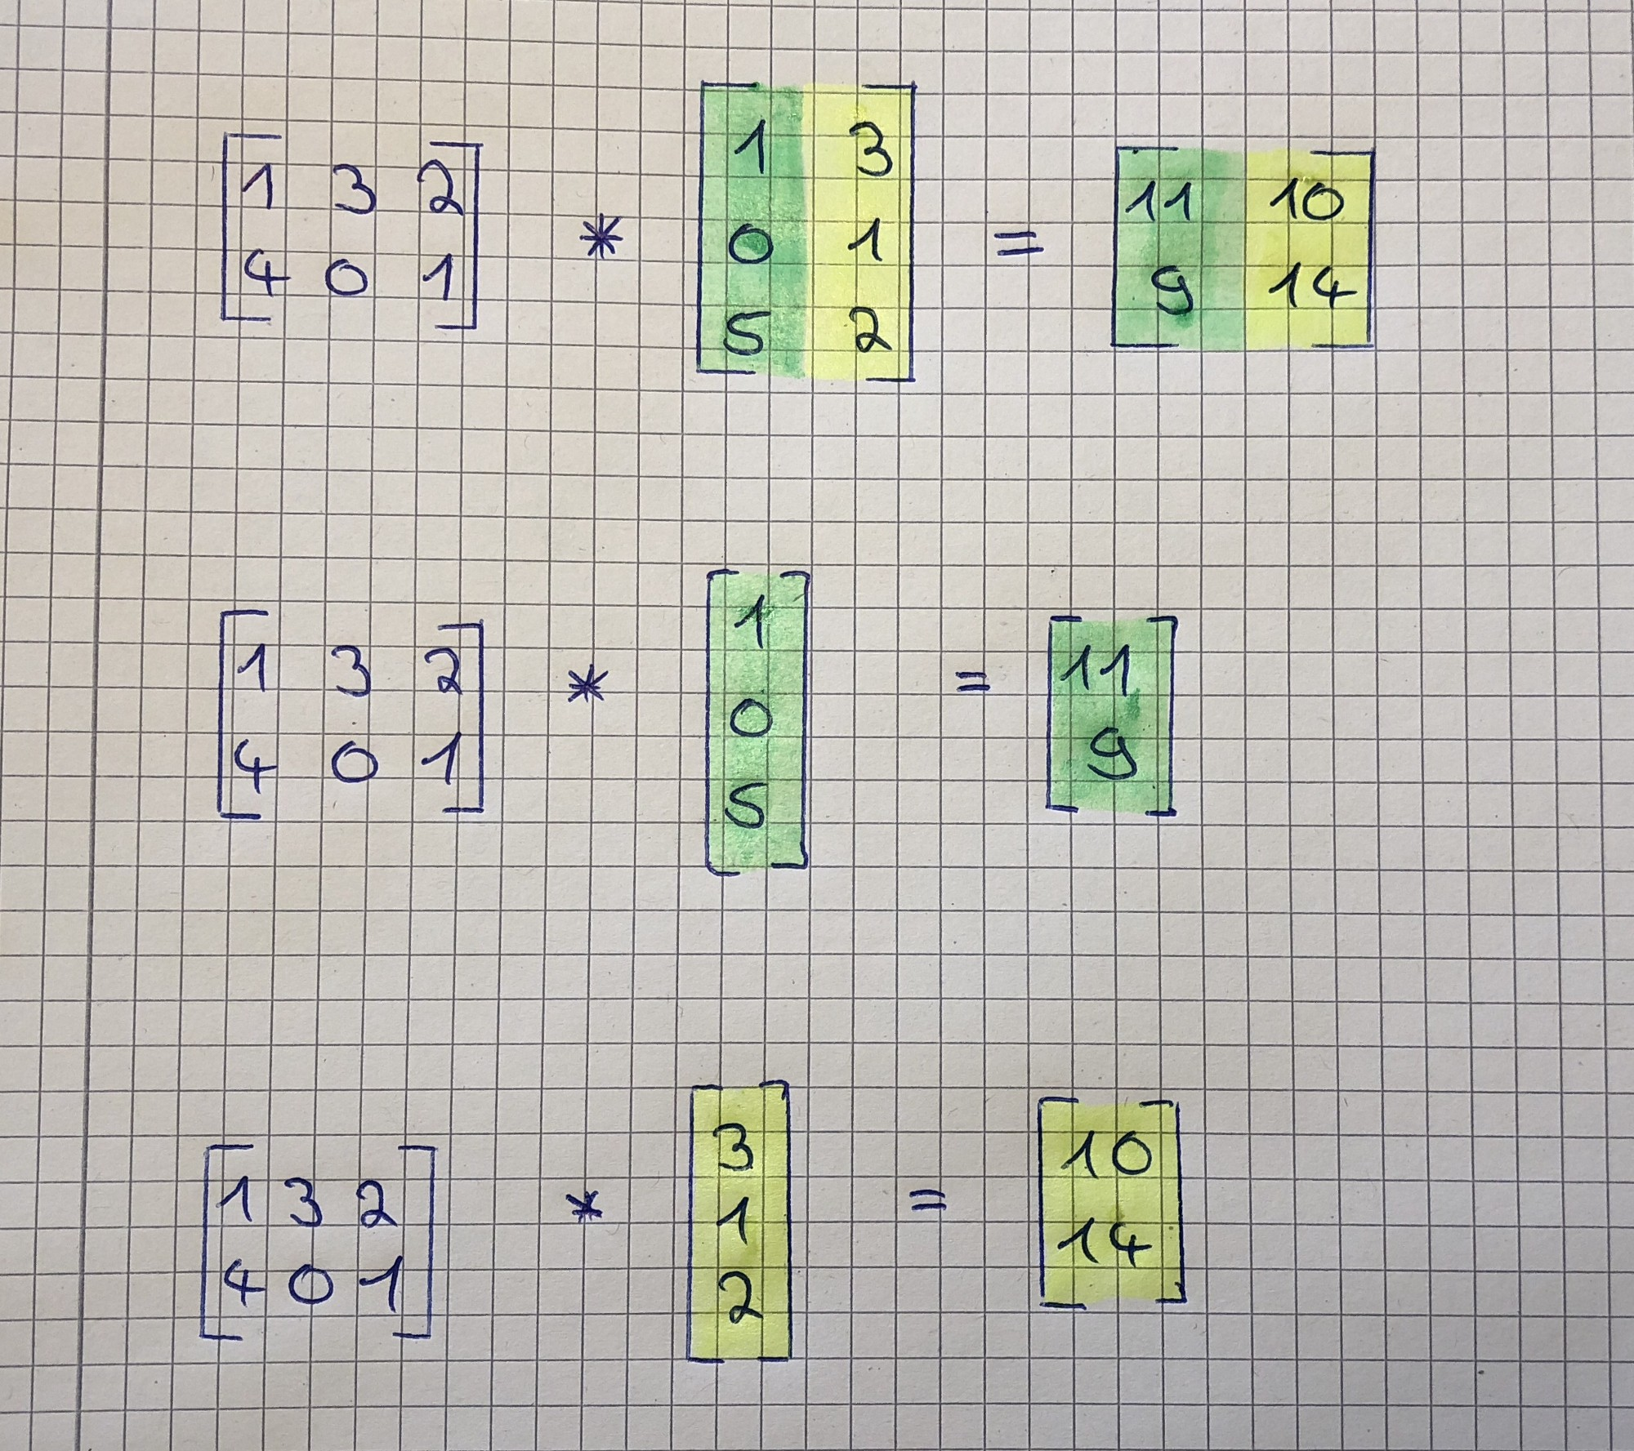
Matrix Multiplication

Slide 18
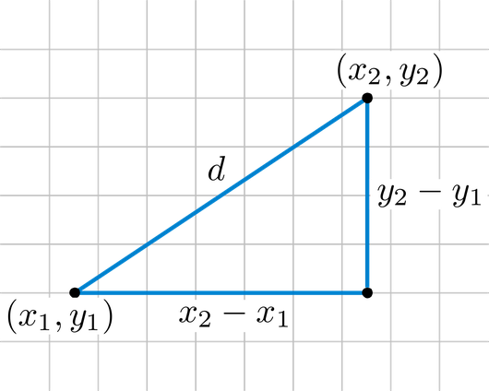
Distance between two vectors

Slide 19
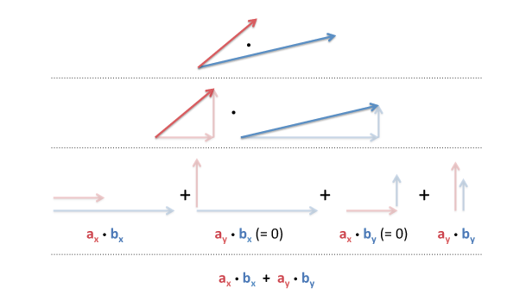
Dot Product

